Slide 1
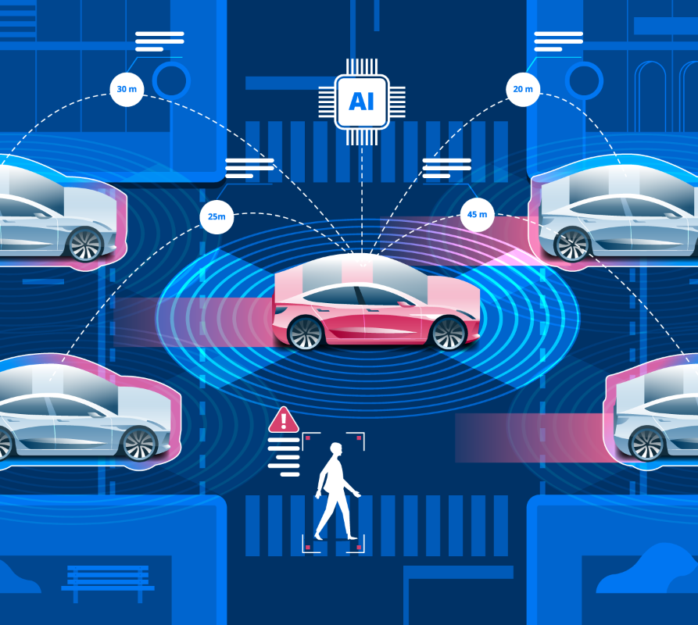
Autonomous Car
Presenters Names :
Farouk Emam Farouk Waked
Youssef Ahmed El-Sayed

Slide 2
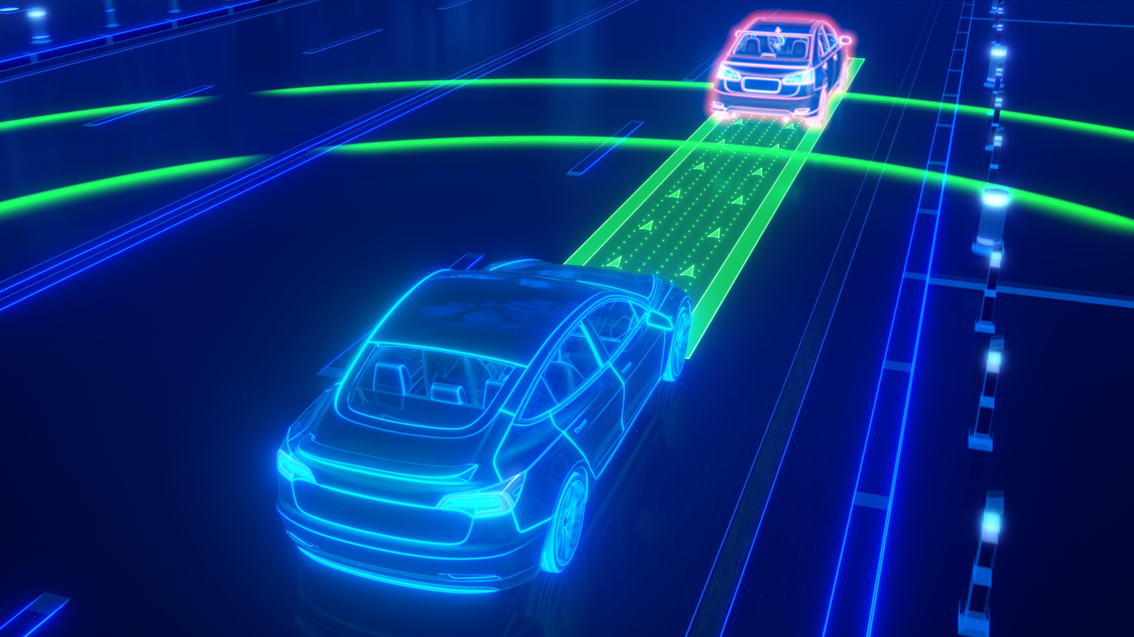
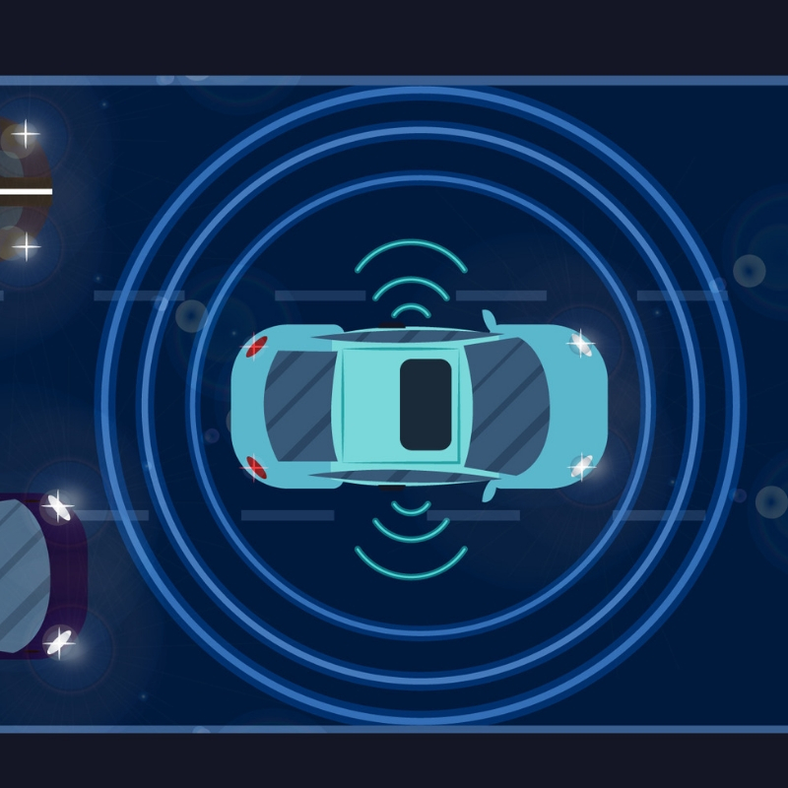
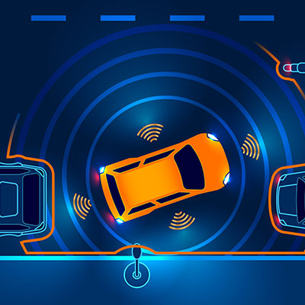
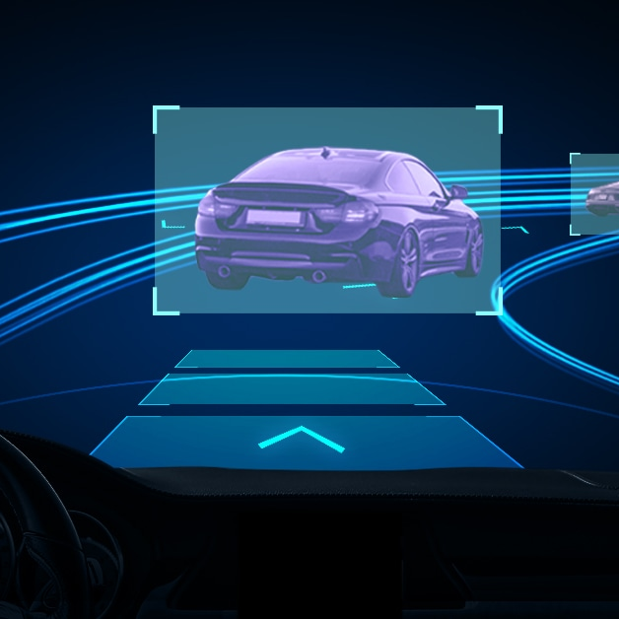
Agenda
Introduction
Project overview
Layered Architecture
Components
Hardware & simulation

Slide 3
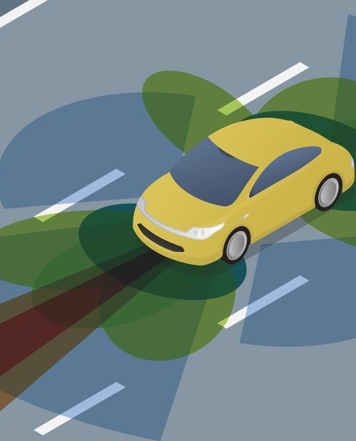

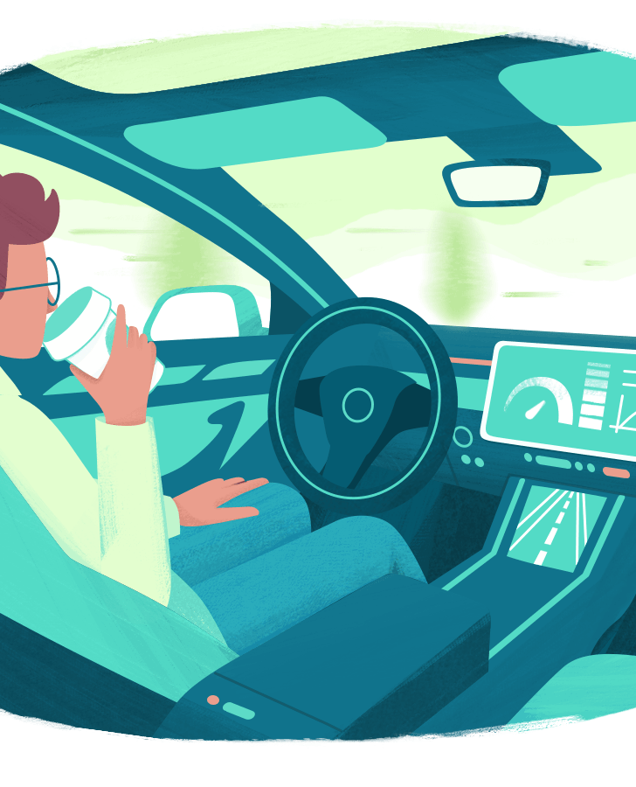

Introduction
This project aims to implement a self-driving Car that can avoid the obstacles with very fast response

Slide 4

Project operation overview
This project is one of the application of atmega32 that integrate with many devices to operate :
When front sensor detect obstacle about 20cm the car will stop and scanning the area around them about four degrees and turn to the area with available space.
If no available space around the car will go back until it find an suitable space and turn to it.
When the backward moving occured the back sensor will be used to scan the back space and when it detect some thing the motion will be reversed

Slide 5
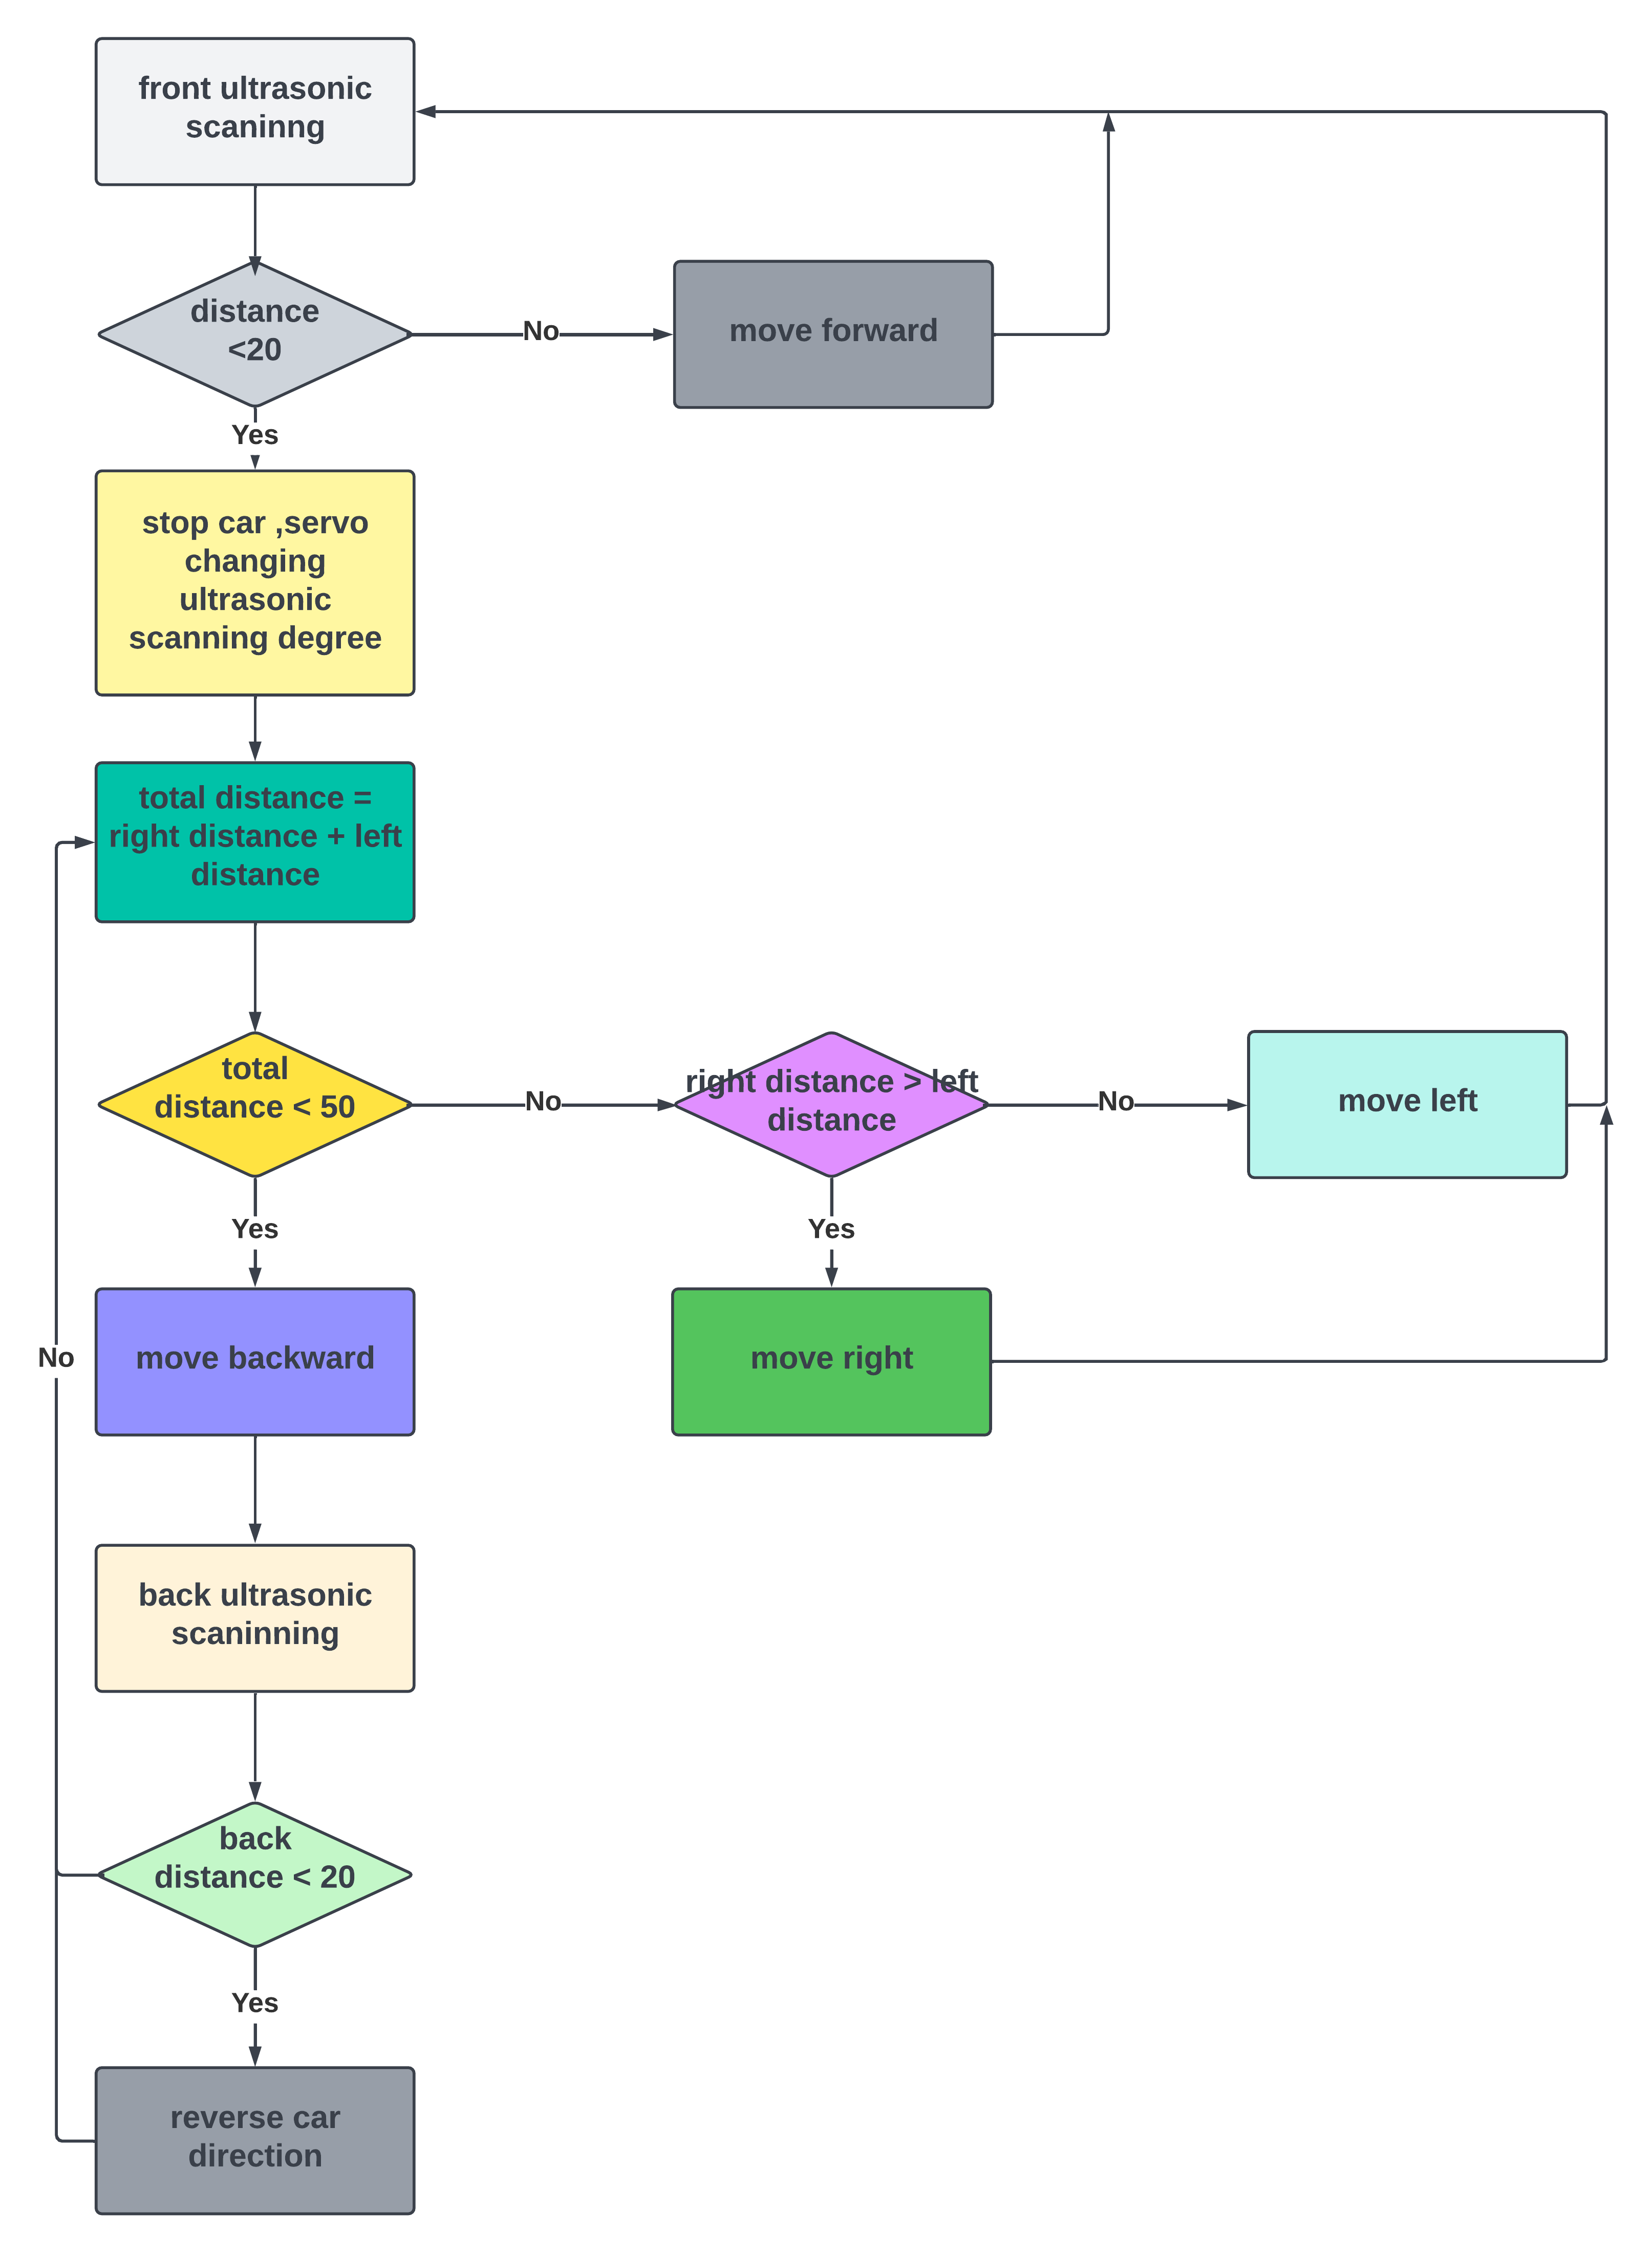
Flow Chart

Slide 6
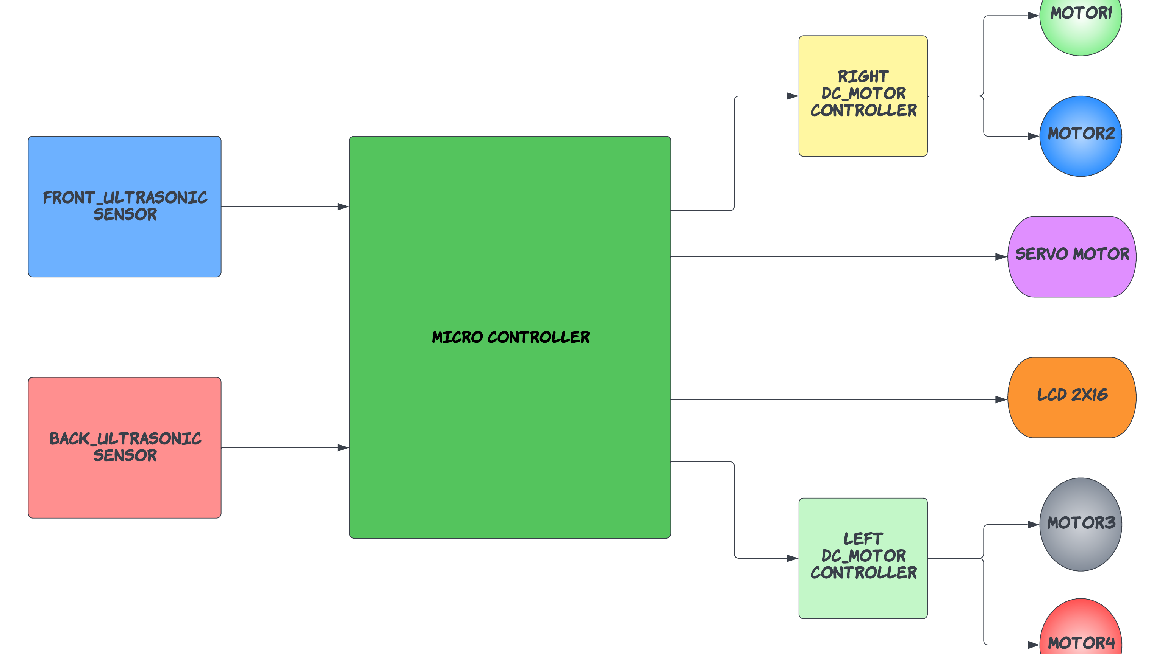
Block Diagram

Slide 7
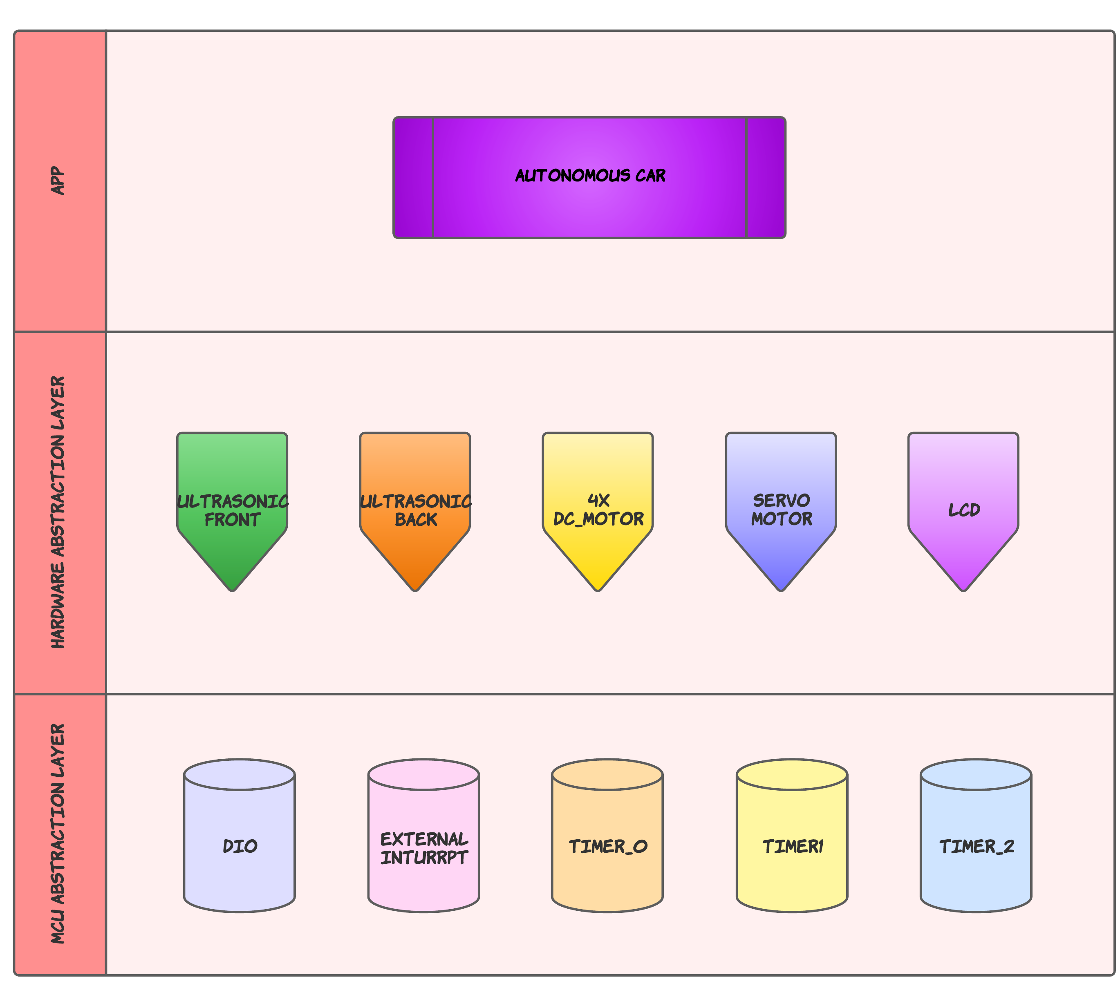
Layered Architecture
MCAL here we have the firmware for all microcontroller peripherals like DIO, ADC, Timer, Interrupt etc..
HAL here we have the device driver for all hardware not inside the microcontroller itself like Keypad, LCD etc..
Application here we write the code related to our application.
Each layer can only communicate with the layer below, so if we change the MCU we only need to change the MCAL layer.

Slide 8
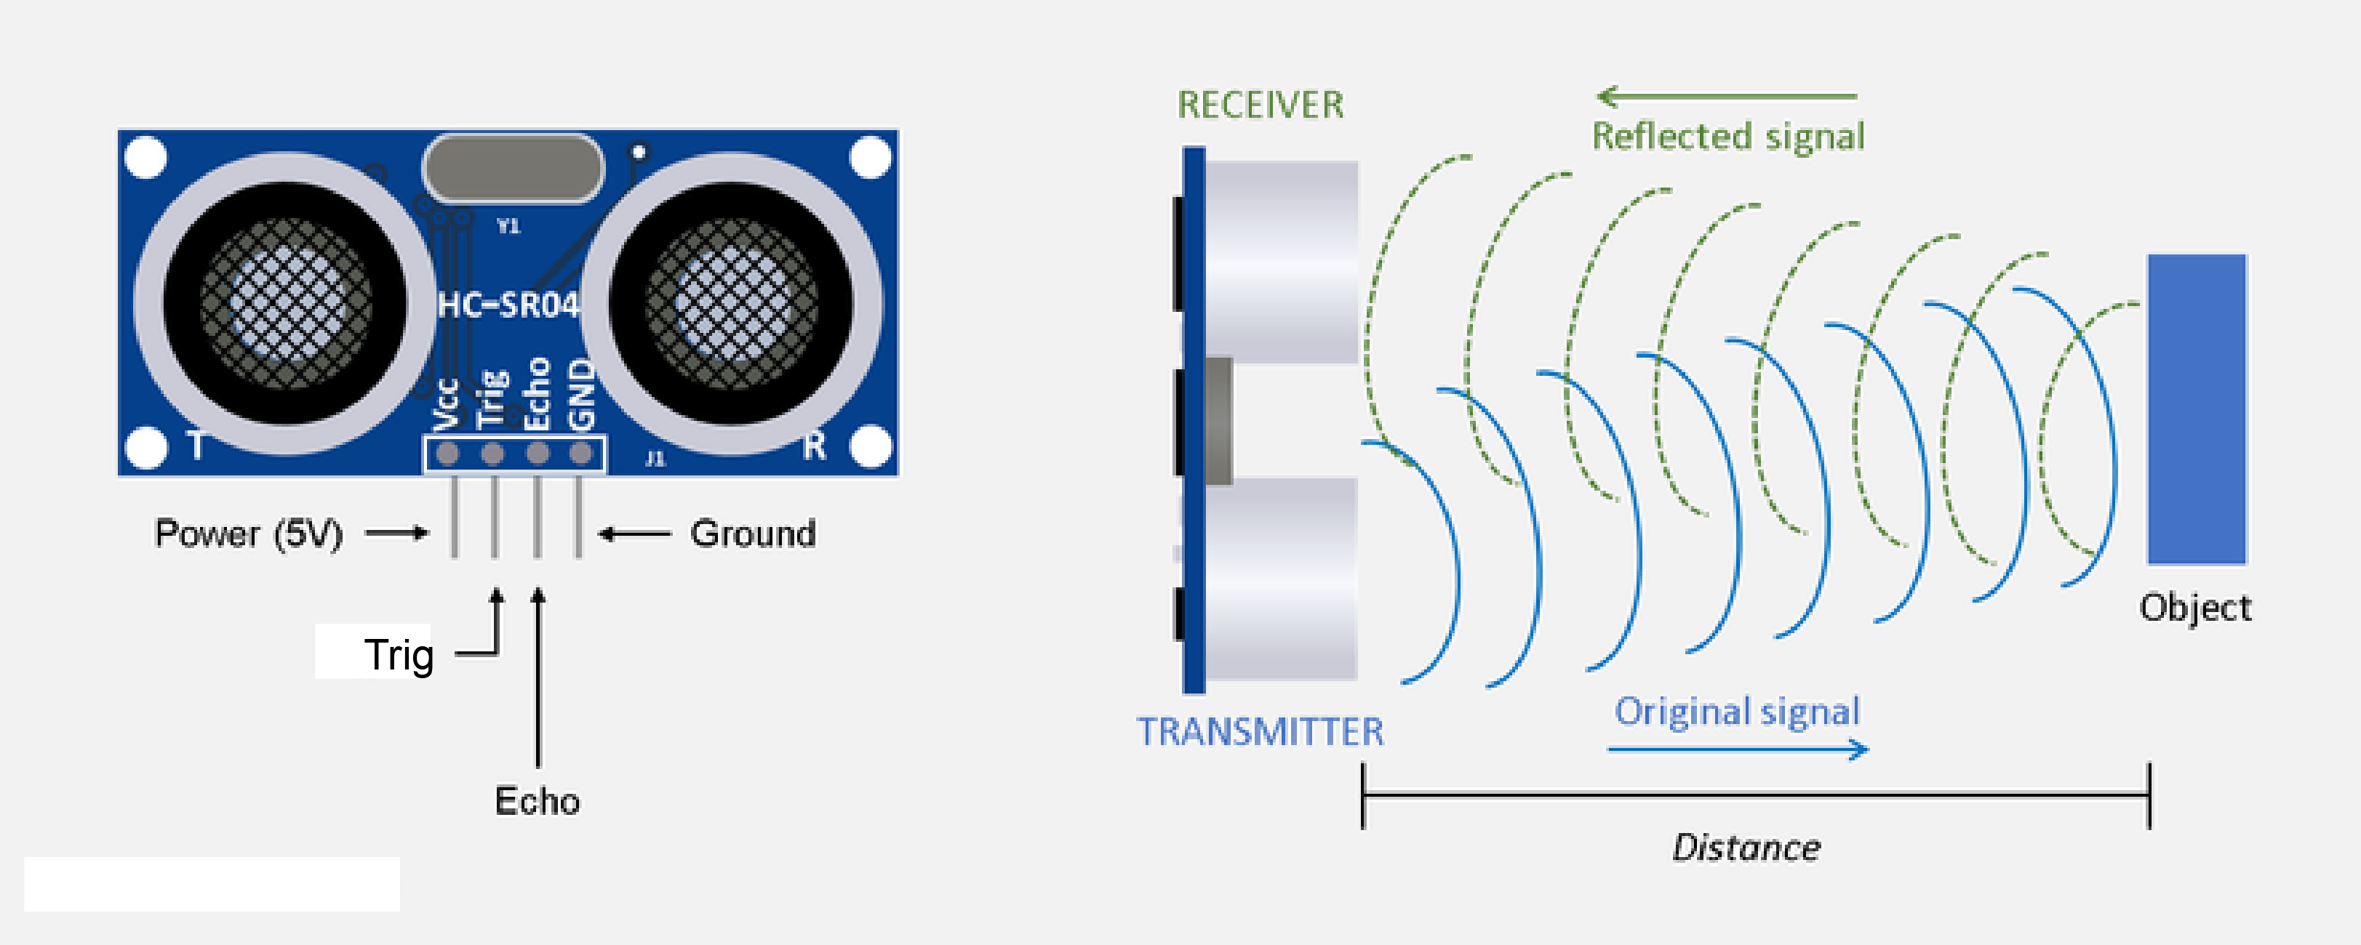
Ultrasonic sensor
Selected drivers for ultrasonic sensors :
Front sensor:
Timer2 Normal_mode
EXT_INT_0 TRIGGER MODE: ANY LOGICAL CHANGE
Back sensor:
Timer0 Normal_mode
EXT_INT_2 TRIGGER MODE: ANY LOGICAL CHANGE

Slide 9
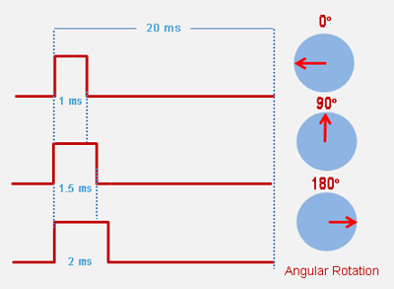
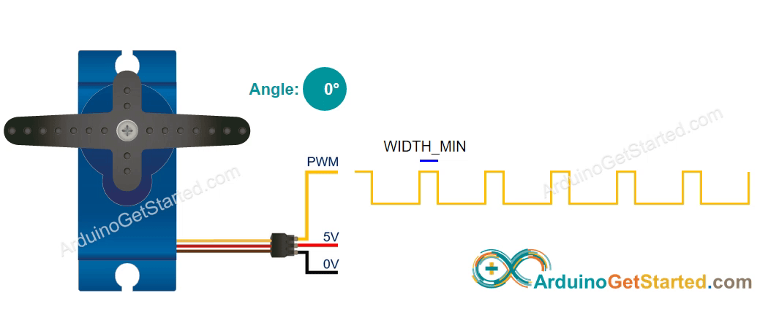
Servo Motor
Selected drivers for Servo_motor:
Timer 1 mode 14 FAST_PWM_S
DIO

Slide 10
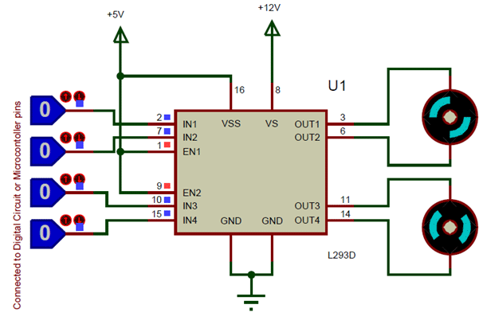
DC Motor Driver L293D
Selected drivers for DC_motor:
DIO

Slide 11
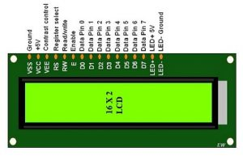
LCD 2X16
Selected drivers for LCD:
DIO

Slide 12
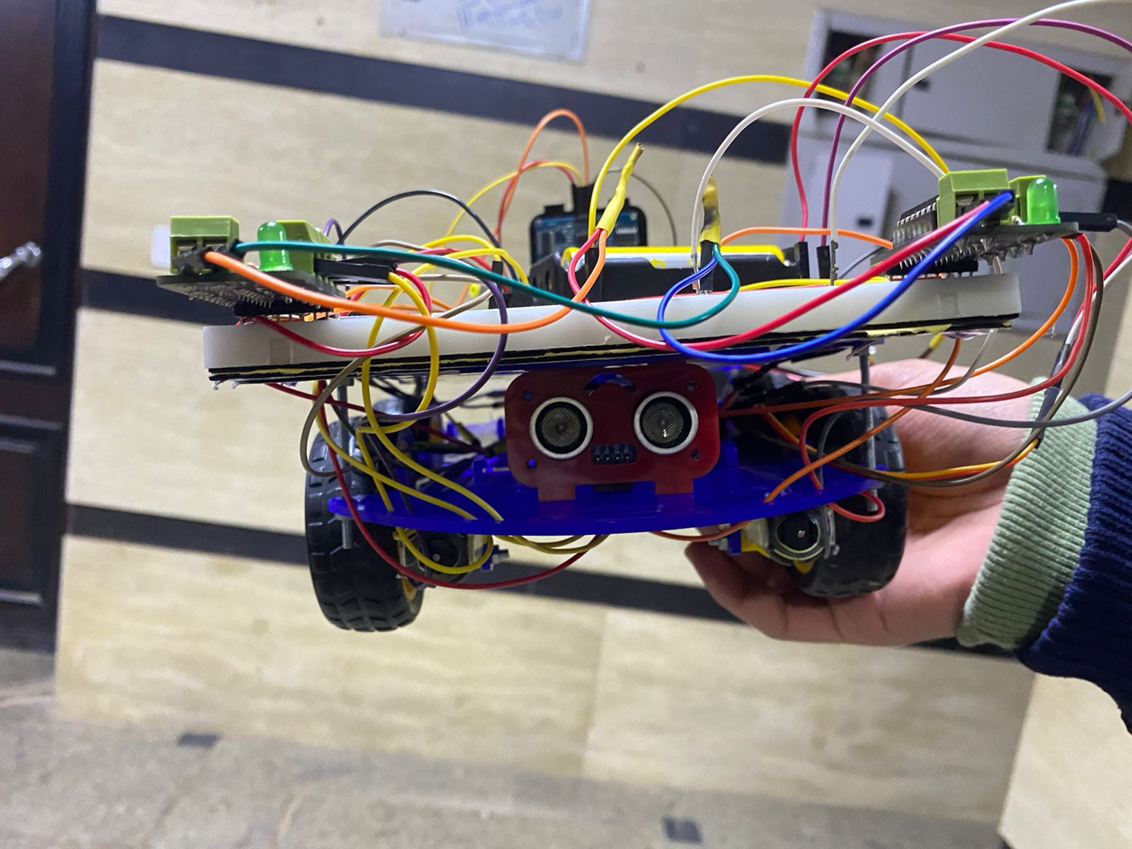
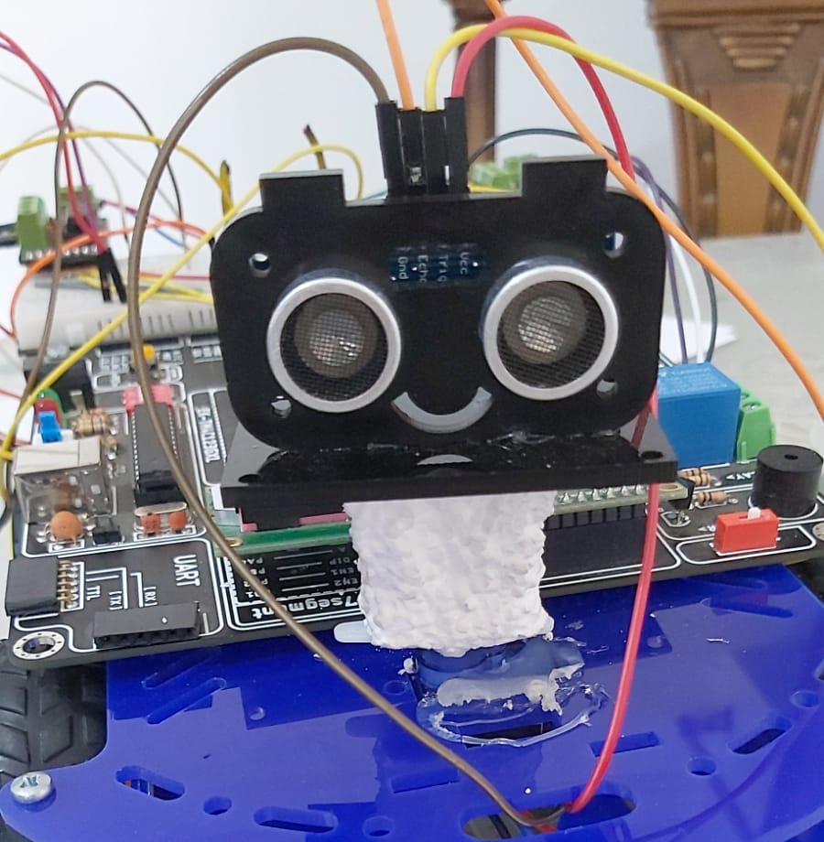
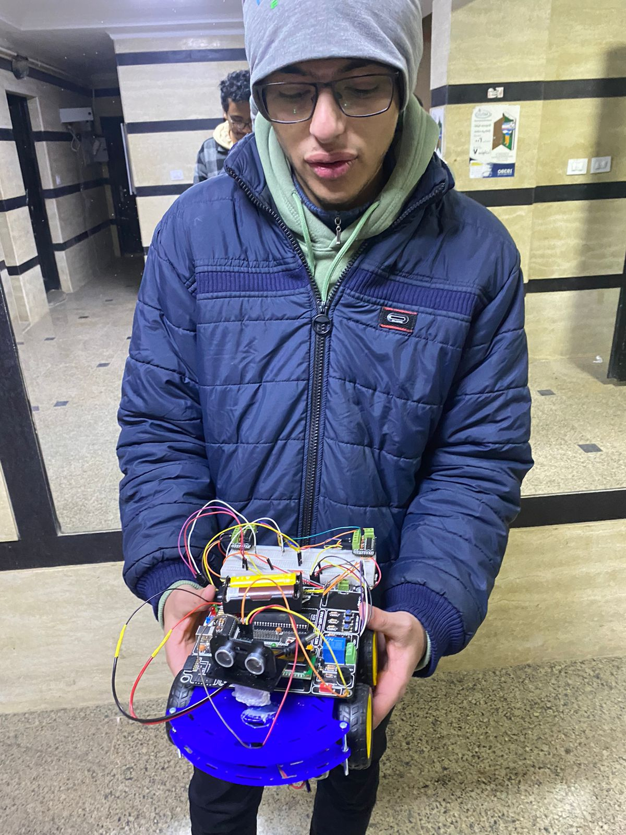
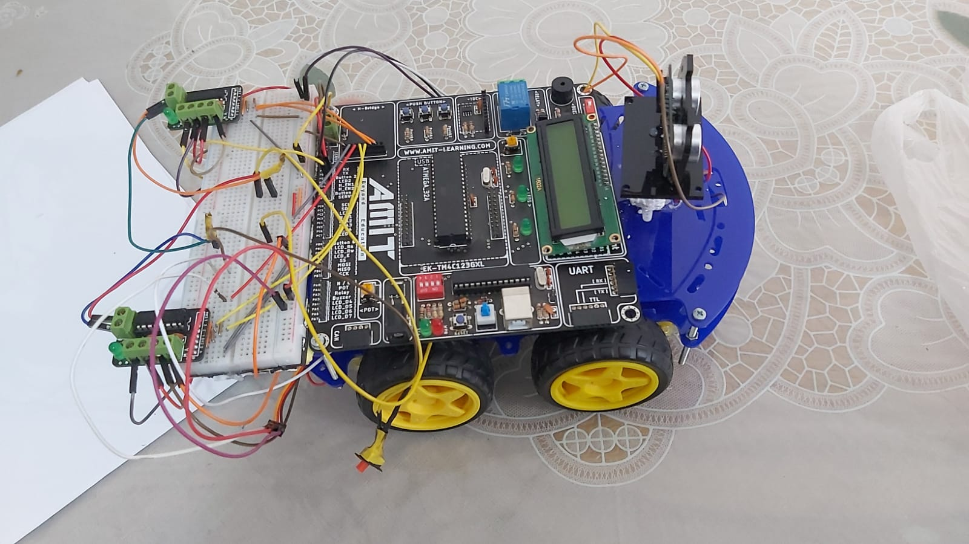
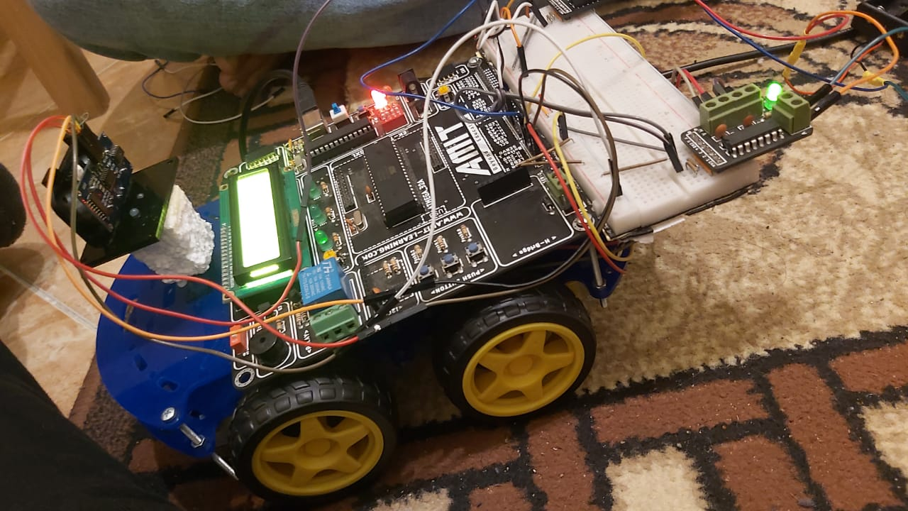
HARDWARE

Slide 13
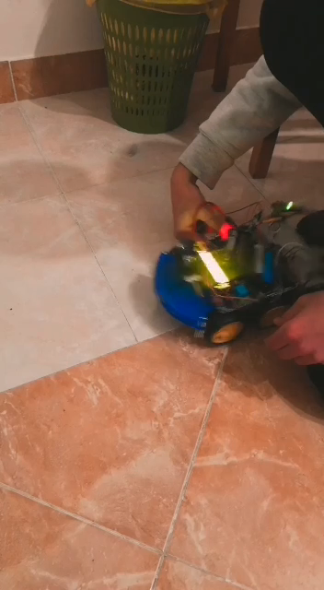

Slide 14
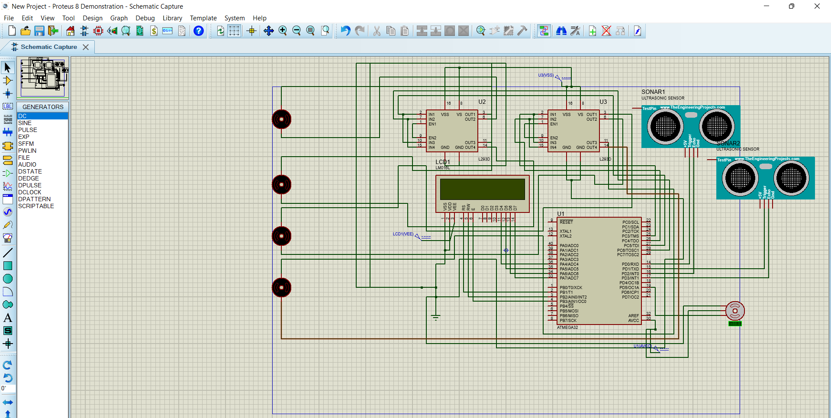

Slide 15
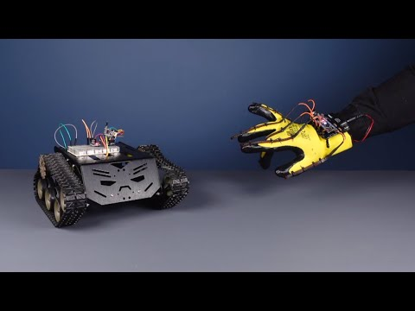
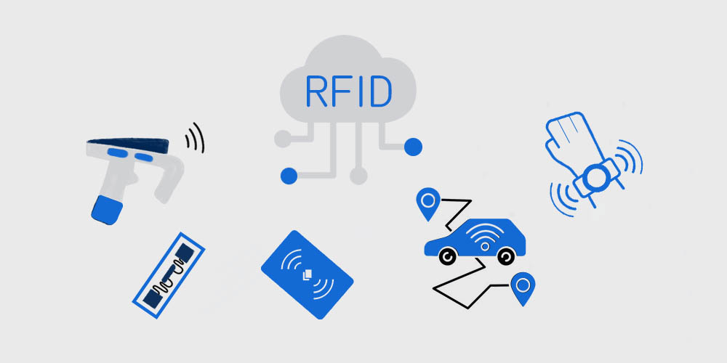
Other features could be added
Using rfid
Flex able sensor control
To avoid Stealing
Control the car direction by hand motion

Slide 16

Team
FAROUK & YOUSSEF

Slide 17


Thank You
Presenter name : Farouk & Youssef
Group : OCT10
PROJECT NAME : Autonomous Car

